Slide 1
theoretical distributions & hypothesis testing

Slide 2
what is a distribution??
describes the ‘shape’ of a batch of numbers
the characteristics of a distribution can sometimes be defined using a small number of numeric descriptors called ‘parameters’

Slide 3
why??
can serve as a basis for standardized comparison of empirical distributions
can help us estimate confidence intervals for inferential statistics
form a basis for more advanced statistical methods
‘fit’ between observed distributions and certain theoretical distributions is an assumption of many statistical procedures

Slide 4
Normal (Gaussian) distribution
continuous distribution
tails stretch infinitely in both directions

Slide 5
μ
σ
σ
symmetric around the mean (μ)
maximum height at μ
standard deviation (σ) is at the point of inflection

Slide 6
a single normal curve exists for any combination of μ, σ
these are the parameters of the distribution and define it completely
a family of bell-shaped curves can be defined for the same combination of μ, σ, but only one is the normal curve

Slide 7
binomial distribution with p=q
approximates a normal distribution of probabilities
p+q=1 ∴ p=q=.5
μ=np=.5n
recall that the binomial theorem specifies that the mean number of successes is np; substitute p by .5
σ=√(np²)=.5√n
simplified from √(n*0.25)

Slide 8
lots of natural phenomena in the real world approximate normal distributions—near enough that we can make use of it as a model
e.g. height
phenomena that emerge from a large number of uncorrelated, random events will usually approximate a normal distribution

Slide 9
standard probability intervals (proportions under the curve) are defined by multiples of the standard deviation around the mean
true of all normal curves, no matter what μ or σ happens to be

Slide 10
P(μ-σ <= μ <= μ+σ) = .683
μ+/-1σ = .683
μ+/-2σ = .955
μ+/-3σ = .997
50% = μ+/-0.67σ
95% = μ+/-1.96σ
99% = μ+/-2.58σ
μ
σ

Slide 11
the logic works backwards
if μ+/-σ < > .68, the distribution is not normal

Slide 12
z-scores
standardizing values by re-expressing them in units of the standard deviation
measured away from the mean (where the mean is adjusted to equal 0)

Slide 13
z-scores = “standard normal deviates”
converting number sets from a normal distribution to z-scores:
presents data in a standard form that can be easily compared to other distributions
mean = 0
standard deviation = 1

Slide 14
z-scores often summarized in table form as a CDF (cumulative density function)
Shennan, Table C (note errors!)
can use in various ways, including determining how different proportions of a batch are distributed “under the curve”

Slide 15
Neanderthal stature
population of Neanderthal skeletons
stature estimates appear to follow an approximately normal distribution…
mean = 163.7 cm
sd = 5.79 cm

Slide 16
Quest. 1: what proportion of the population is >165 cm?
z-score = ?
z-score = (165-163.7)/5.79 = .23 (+)
mean = 163.7 cm
sd = 5.79 cm

Slide 17
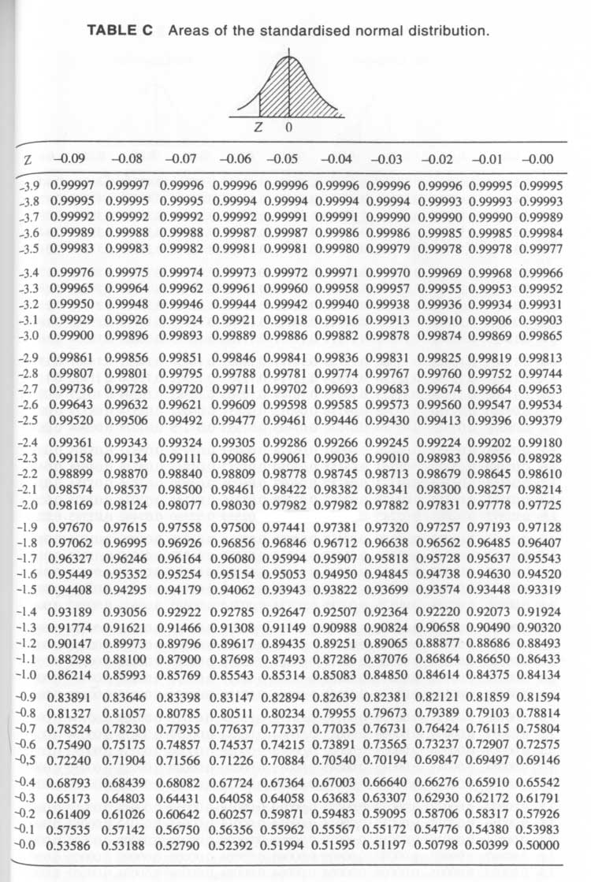
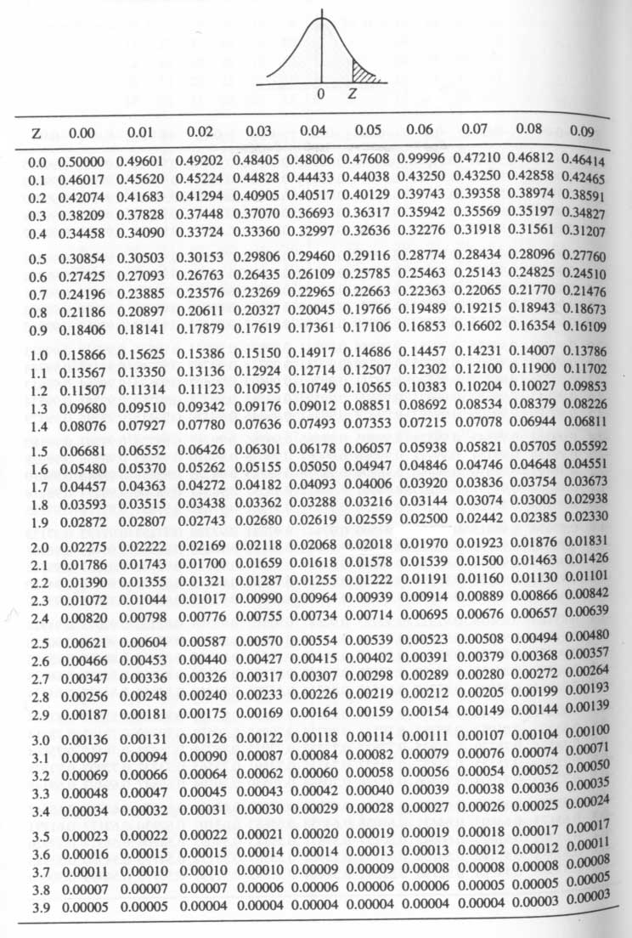
.48803
.48405
.48006
.47608

Slide 18
Quest. 1: what proportion of the population is >165 cm?
z-score = .23 (+)
using Table C-2
cdf(.23) = .40905
40.9%

Slide 19
Quest. 2: 98% of the population fall below what height?
Cdf(x)=.98
can use either table
Table C-1; look for .98
Table C-2; look for .02

Slide 20
.48803
.48405
.48006
.47608

Slide 21
Quest. 2: 98% of the population fall below what height?
Cdf(x)=.98
can use either table
Table C-1; look for .98
Table C-2; look for .02
both give you a value of 2.05 for z
solve z-score formula for x:
x = 2.05*5.79+163.7 = 175.6cm

Slide 22
“sample distribution of the mean”
we don’t know the shape of the distribution an underlying population
it may not be normal
we can still make use of some properties of the normal distribution
envision the distribution of means associated with a large number of samples…

Slide 23
central limits theorem
distribution of means derived from sets of random samples taken from any population will tend toward normality
conformity to a normal distribution increases with the size of samples
these means will be distributed around the mean of the population

Slide 24
we usually have one of these samples…
we can’t know where it falls relative to the population mean, but we can estimate odds about how far it is likely to be…
this depends on
sample size
an estimate of the population variance

Slide 25
the smaller the sample and the more dispersed the population, the more likely that our sample is far from the population mean
this is reflected in the equation used to calculate the variance of sample means:

Slide 26
the standard deviation of sample means is the standard error of the estimate of the mean:

Slide 27
you can use the standard error to calculate a range that contains the population mean, at a particular probability, and based on a specific sample:
(where Z might be 1.96 for .95 probability, for example)

Slide 28
Shennan
50 arrow points
mean length = 22.6 mm
sd = 4.2 mm
standard error = ??
22.6 +/- 1.96*.594
22.6 +/- 1.16
95% probability that the population mean is within the range 21.4 to 23.8

Slide 29
hypothesis testing
originally used where decisions had to be made
now more widely used—even where evaluation of data would be more appropriate
involves testing the relative strength of null vs. alternative hypotheses

Slide 30
hypothesis testing
Examples
If I (decrease the amount of water given to herbs) then (the herbs will increase in size).
If I (give patients counseling in addition to medication) then (their overall depression scale will decrease).
If I (give exams at noon instead of 7) then (student test scores will improve).
If I (look in this certain location) then (I am more likely to find new species).

Slide 31
“null hypothesis”
H₀
usually highly specific and explicit
often a hypothesis that we suspect is wrong, and wish to disprove
e.g.:
the means of two populations are the same (H₀:μ₁=μ₂ )
two variables are independent
two distributions are the same

Slide 32
“alternative hypothesis”
H₁
what is logically implied when H₀ is false
often quite general or nebulous compared to H₀
the means of two populations are different: H₁:μ₁< >μ₂

Slide 33
testing H₀ and H₁
together, constitute mutually exclusive and exhaustive possibilities
you can calculate conditional probabilities associated with sample data, based on the assumption that H₀ is correct
P(sample data|H₀ is correct)
if the data seem highly improbable given H₀, H₀ is rejected, and H₁ is accepted

Slide 34
what can go wrong???
since we can never know the true state of underlying population, we always run the risk of making the wrong decision…

Slide 35
Type 1 error
P(rejecting H₀|H₀ is true)
probability of rejecting a true null hypothesis
e.g.: deciding that two population means are different when they really are the same
P = significance level of the test = alpha (α)
in “classic” usage, set before the test

Slide 36
smaller alpha values are more conservative from the point of view of Type I errors
compare a alpha-level of .01 and .05:
we accept the null hypothesis unless the sample is so unusual that we would only expect to observe it 1 in 100 and 5 in 100 times (respectively) due to random chance
the larger value (.05) means we will accept less unusual sample data as evidence that H₀ is false
the probability of falsely rejecting it (i.e., a Type I error) is higher

Slide 37
the more conservative (smaller) alpha is set to, the greater the probability associated with another kind of error—Type II error

Slide 38
counts of burials for the younger age-classes appear to be disproportionally high among “poor” burials
can this be explained away as an example of random chance?
or
do poor burials constitute a different population, with respect to age-classes, than rich burials?
we might want to make a decision about this…

Slide 39
Type II error
P(accepting H₀|H₀ is false)
failing to reject the null hypothesis when it actually is false
the probability of a Type II error (β) is generally unknown

Slide 40
the relative costs of Type I vs. Type II errors vary according to context
in general, Type I errors are more of a problem
e.g., claiming a significant pattern where none exists
 | H₀ is correct | H₀ is incorrect
H₀ is accepted | correct decision | Type II error (β)
H₀ is rejected | Type I error (α) | correct decision

Slide 41
example 1
mortuary data (Shennan)
burials characterized according to 2 wealth (poor vs. wealthy) and 6 age categories (infant to old age)
 | Rich | Poor
Infans I | 6 | 23
Infans II | 8 | 21
Juvenilis | 11 | 25
Adultus | 29 | 36
Maturus | 19 | 27
Senilis | 3 | 4
Total | 76 | 136

Slide 42
we can get a visual sense of the problem using a cumulative frequency plot:

Slide 43
K-S test (Kolmogorov-Smirnov test) assesses the significance of the maximum divergence between two cumulative frequency curves
H₀:dist₁=dist₂
an equation based on the theoretical distribution of differences between cumulative frequency curves provides a critical value for a specific alpha level
differences beyond this value can be regarded as significant (at that alpha level), and not attributed to random processes…

Slide 44
if alpha = .05, the critical value =
1.36*√(n₁+n₂)/n₁n₂
1.36*√(76+136)/76*136 = 0.195
the observed value = 0.178
0.178 < 0.195; don’t reject H₀
Shennan: failing to reject H₀ means there is insufficient evidence to suggest that the distributions are different—not that they are the same
does this make sense?
D_{max}=.178

Slide 45
example 2
survey data → 100 sites
broken down by location and time:
early
late
Total
piedmont
31
19
50
plain
19
31
50
Total
50
50
100

Slide 46
we can do a chi-square test of independence of the two variables time and location
H₀:time & location are independent
alpha = .05
time
time
location
location
H₀
H₁

Slide 47
χ² values reflect accumulated differences between observed and expected cell-counts
expected cell counts are based on the assumptions inherent in the null hypothesis
if the H₀ is correct, cell values should reflect an “even” distribution of marginal totals
early
late
Total
piedmont
25
50
plain
50
Total
50
50
100

Slide 48
chi-square = Σ((o-e)²/e)
observed chi-square = 4.84
we need to compare it to the “critical value” in a chi-square table:

Slide 49
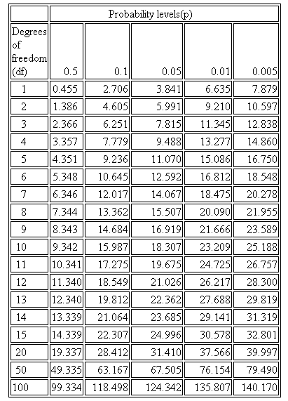

Slide 50
chi-square = Σ((o-e)²/e)
observed chi-square = 4.84
chi-square table:
critical value (alpha = .05, 1 df) is 3.84
observed chi-square (4.84) > 3.84
we can reject H₀
H₁: time & location are not independent

Slide 51
what does this mean?
early
late
Total
piedmont
31
19
50
plain
19
31
50
Total
50
50
100

Slide 52
example 3
hypothesis testing using binomial probabilities
coin testing: H₀:p=.5
i.e. is it a fair coin??
how could we test this hypothesis??

Slide 53
you could flip the coin 7 times, recording how many times you get a head
calculate expected results using binomial theorem for P(7,k,.5)

Slide 54
define rejection subset for some level of alpha
it is easier and more meaningful to adopt non-standard α levels based on a specific rejection set
ex:
{0,7}
α = .016

Slide 55
{0,7}; α=.016
under these set-up conditions, you reject H₀ only if you get 0 or 7 heads
if you get 6 heads, you accept the H₀ at a alpha level of .016 (1.6%)
this means that IF THE COIN IS FAIR, the outcome of the experiment could occur around 1 or 2 times in 100
if you have proceeded with an alpha of .016, this implies that you regard 6 heads as fairly likely even if H₀ is correct

Slide 56
but you don’t really want to know this…
what you really want to know is
IS THE COIN FAIR??
you may NOT say that you are 98.4% sure that the H₀ is correct
these numerical values arise from the assumption that H₀ IS correct
but you haven’t really tested this directly…

Slide 57
{0,1,6,7}; α=.126
you could increase alpha by widening the rejection set
this increases the chance of a Type I error—doubles the number of outcomes that could lead you to reject the null hypothesis
it makes little sense to set alpha at .05
your choices are really between .016 and .126

Slide 58
NOTE
add discussion/example of calculating beta, and the trade-off between alpha and beta…
too advanced for this class…
HIDE THIS SLIDE…

Slide 59
problems…
a) hypothesis testing often doesn’t answer very directly the questions we are interested in
we don’t usually have to make a decision in archaeology
we often want to evaluate the strength or weakness of some proposition or hypothesis

Slide 60
we would like to use sample data to tell us about populations of interest:
P(P|D)
but, hypothesis testing uses assumptions about populations to tell us about our sample data:
P(D|P) or P(D|H₀ is true)

Slide 61
b) classical hypothesis testing encourages uncritical adherence to traditional procedures
“fix the alpha level before the test, and never change it”
“use ‘standard’ alpha levels: .05, .01”
→ if you fail to reject the H₀, there seems to be nothing more to say about the matter…

Slide 62
early
late
Total
piedmont
31
19
50
plain
19
31
50
(shift 3 sites)
Total
50
50
100
early
late
Total
piedmont
29
20
49
no longer significant at alpha = .05 !
plain
21
30
51
Total
50
50
100

Slide 63
early
late
Total
piedmont
31
19
50
plain
19
31
50
Total
50
50
100
α = .016
early
late
Total
piedmont
29
20
49
plain
21
30
51
Total
50
50
100
α = .072

Slide 64
better to report the actual alpha value associated with the statistic, rather than just whether or not the statistic falls into an arbitrarly defined critical region
most computer programs do return a specific alpha level
you may get a reported alpha of .000
not the same as “0”
means α < .0005 (←report it like this)

Slide 65
α
.05
χ²
accept H₀
reject H₀
critical: 3.84
observed: 4.84
α .016
χ² observed: 4.84

Slide 66
c) encourages misinterpretation of results
it’s tempting (but wrong) to reverse the logic of the test
having failed to reject the H₀ at an alpha of .05, we are not 95% sure that the H₀ is correct
if you do reject the H₀, you can’t attach any specific probability to your acceptance of H₁

Slide 67
d) the whole approach may be logically flawed:
what if the tests lead you to reject H₀?
this implies that H₀ is false
but the probabilities that you used to reject it are based on the assumption that H₀ is true; if H₀ is false, these odds no longer apply
rejecting H₀ creates a catch-22; we accept the H₁, but now the probabilistic evidence for doing so is logically invalidated

Slide 68
Estimation
[revisit later, if time permits…]

